Slide 1
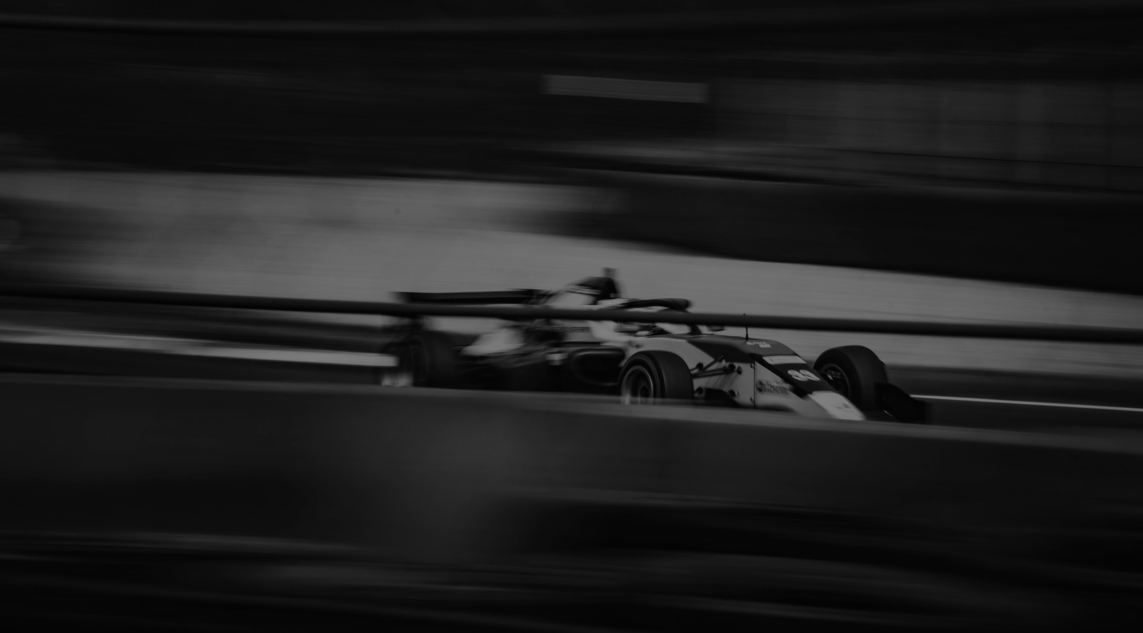
Five9 x SPORTFIVE RECOMMENDATION: THE BEST FIT FOR Five9
EXEMPLARY
Rights package*
TGR HAAS F1 TEAM
PARTNERSHIP
Brand & IP Rights
Official Partner designation
Associated IP and promotional rights
Car & Team Branding
Car branding, potentially 2 positions
Driver, mechanic and team principal apparel
Selected team assets
Activation
Driver and team appearances, in-market and virtual
Replica/show car usage
Simulator usage
Digital & Social
Digital and social media support
Co-branded content
Partner presence on the team website
Hospitality
Paddock access
Paddock Club tickets
Hospitality and paddock branding
Business Value
B2B introductions across the team’s partner network
Merchandise allocation
Licensing opportunities
*Subject to approval
39

Slide 2
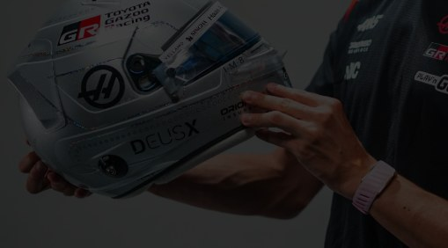
Five9 x SPORTFIVE RECOMMENDATION: THE BEST FIT FOR Five9
EXEMPLARY
Rights package*
OLLIE BEARMAN
ATHLETE PARTNERSHIP
Brand & IP Rights
Official ambassador designation
Territory: global
IP Usage
Digital and social media
OOH and TVC
POS and retail marketing
Helmet Branding
Five9 branding on Ollie’s helmet
At all 24 Formula 1 races
Content & Social
Production time with Ollie
Social media usage
Experiences
Meet & greets
Signed merchandise
Formula 1 Paddock Club hospitality
Investment
Fee: $2–2.5M p.a.
*Subject to approval
39

Slide 3
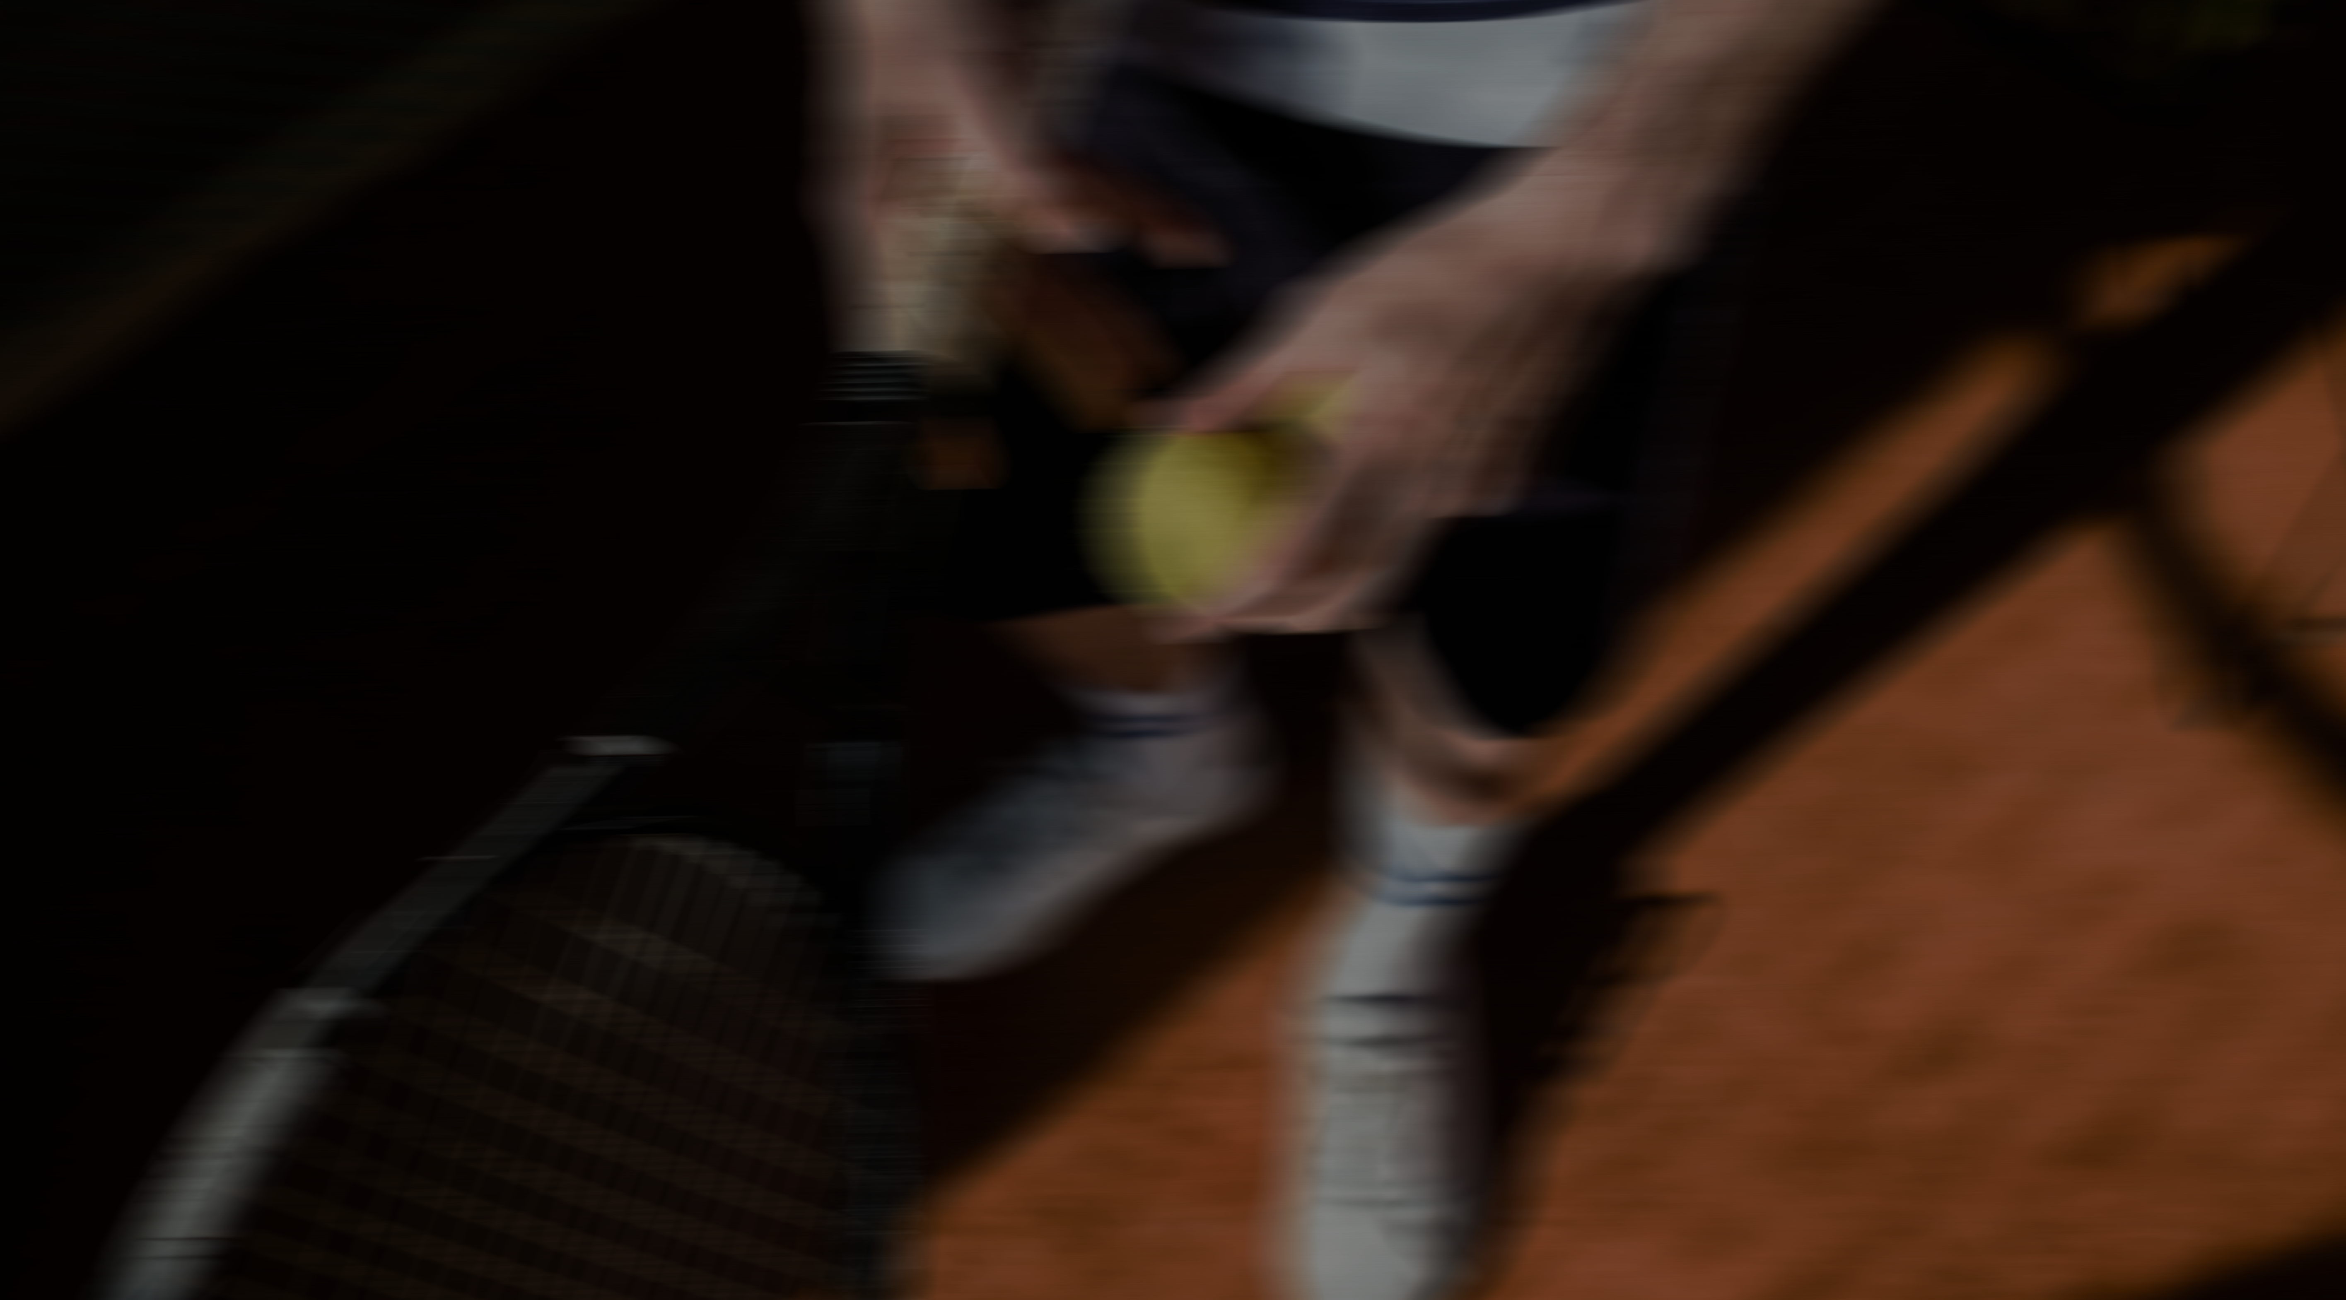
Five9 x SPORTFIVE RECOMMENDATION: THE BEST FIT FOR Five9
EXEMPLARY
Rights package*
TOURNAMENT PARTNERSHIP
Brand & IP Rights
Official Partner designation
Category exclusivity
Use of event and partner IP
Venue Visibility
LED and videoboard branding
On-site signage and exposure
Hospitality area branding
Experiences
Player meet & greets
Coin toss participation
Behind-the-scenes access
Digital & Social
Dedicated social media content
Website integration and advertising
Inclusion across tournament channels
Hospitality
Premium tickets and VIP access
Private suites and hospitality areas
Client entertainment opportunities
Business Value
Access to affluent, premium audiences
Global media exposure
High-quality B2B networking environment
*Subject to approval
39

Slide 4

Five9 x SPORTFIVE RECOMMENDATION: THE BEST FIT FOR Five9
EXEMPLARY
Rights package*
TENNIS
AMBASSADOR
Brand & IP Rights
Official Ambassador designation
Territory: global
IP Usage
Digital and social media
OOH and TVC
POS and retail marketing
Experiences
Meet & greets
Signed merchandise
Content & Social
Production time
Social media posts
Hospitality
Hospitality tailored to Five9’s needs
Investment
Djokovic: $2M
Zverev: $1.5M
Jódar: $1M
Shelton: $1.5M
*Subject to approval
39

Slide 5

Five9 x SPORTFIVE RECOMMENDATION: THE BEST FIT FOR Five9
EXEMPLARY
Rights package*
EUROPEAN FOOTBALL CLUBPARTNER
Brand & IP Rights
Official Partner status
Category exclusivity
Club IP Rights
Joint marketing campaings
Stadium Exposure
Stadium branding
LED exposure
Fan zone activations
Hospitality area branding
Experiences
Player meet & greets
Training ground experiences
Exclusive content opportunities
Club insider moments
Digital & Social
Social integrations
Branded content
Website and app presence
Fan engagement campaigns
Hospitality
VIP hospitality
Premium seating
Executive lounges
Client entertainment
Business Value
Consumer engagement
Lead generation
B2B networking
Commercial growth
*Subject to approval
51

